Slide 1
Car Accident Severity
Moksh Datta
github.com/makoshie

Slide 2
INTRODUCTION
Traffic accidents are a cause of 1.35 million deaths globally in 2016. Main cause of death among those aged 15–29 years. Predicted to become the 7th leading cause of death by 2030. Predicting the accident severity in advance could be used to send the exact required staff and equipment to the place of the accident, thus saving a significant amount of lives each year. Road safety should be a prior interest for governments, local authorities and private companies investing in technologies that can help reduce accidents and improve overall driver safety

Slide 3
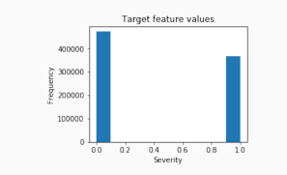
EDA-Target
The target feature a binary classifier, describing the accident severity. 0: low severity. 1: high severity, from hospitalized wounded injuries to death.
It is a balanced labelled dataset with more cases of lower severity

Slide 4
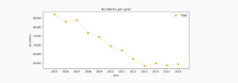
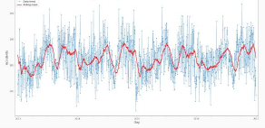
EDA-Seasonality
The number of traffic accidents decreased over the years from 2005 to 2013, after which the trend became stable.

Slide 5
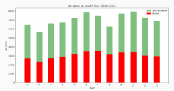
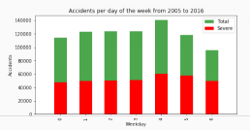
EDA-Seasonality
Accidents increase from March to June and then again in September, decreasing at the end of the year.
Steady trend during the week. More accidents on Friday and less on Sunday

Slide 6
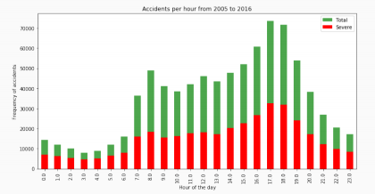
EDA-Seasonality
Spikes: 8am: people go to work 5-6pm: people return home.

Slide 7
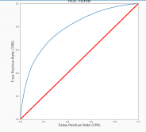
Results
This table reports the results of the evaluation of each model. Algorithm Jaccard f1-score Precision Recall Time(s) Random Forest 0.722 0.72 0.724 0.591 6.588 Logistic Regression 0.661 0.65 0.667 0.456 6.530 KNN 0.664 0.66 0.652 0.506 200.58 SVM 0.659 0.65 0.630 0.528 403.92 With no doubt the Random Forest is the best model, in the same time as the log. res. it improves the accuracy from 0.66 to 0.72 and the recall from 0.45 to 0.59.

Slide 8
Conclusion
Built useful models to predict the severity of a traffic accident. Accuracy of the models has room for improvement.

